Slide 1
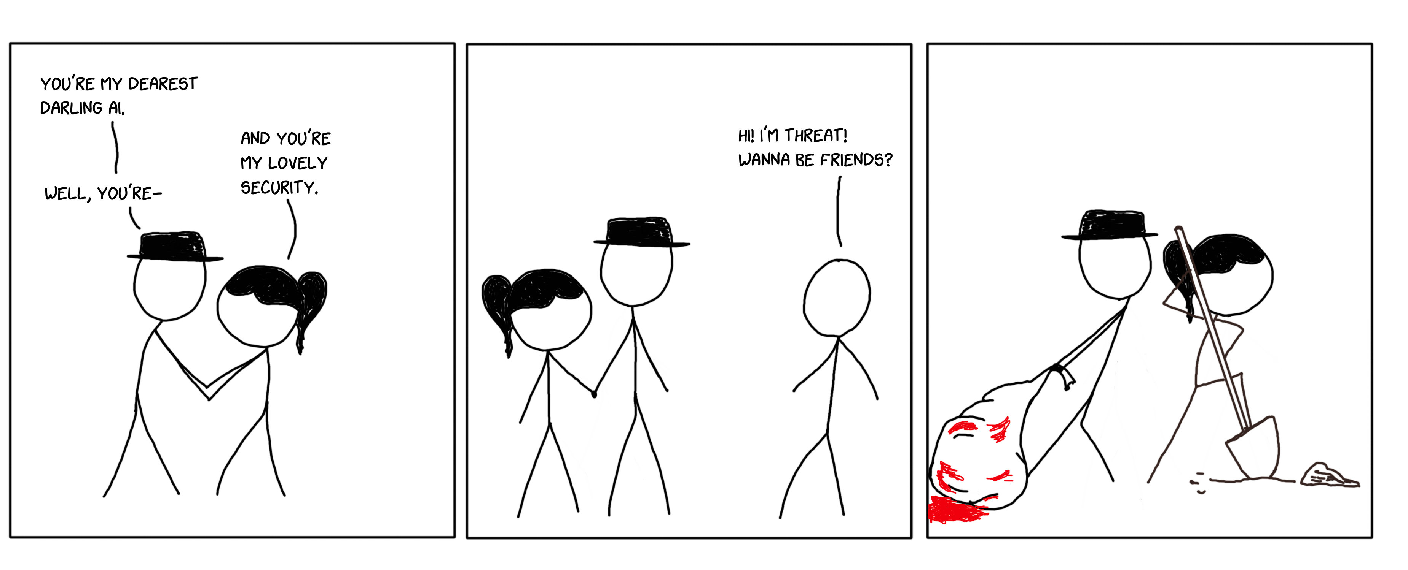
Ai + Security = AiSec
Victoria Almazova
Cecilie Widsteen

Slide 2
Speakers
Cecilie Widsteen
Victoria Almazova
AI expert
Cool girl!
ADD DESCRIPTION
Security expert
Cool girl!
ADD DESCRIPTION

Slide 3
Agenda
Introduction
Overview
Demo
Wrap up and conclusions
Q&A
Useful resources

Slide 4
Introduction

Slide 5
Security objectives
Security controls
Challenges in the security world
What is AI Security
Using AI to improve security
Defending against AI driven cyber attacks

Slide 6
AI objectives
Cecilie

Slide 7
Why is it important now?
Cecilie and Victoria: key points

Slide 8
Overview

Slide 9
What are use cases?
E-mail monitoring
Network threat analysis and malware detection
AI against AI-based threats
AI to automate repetitive security tasks

Slide 10
Automate repetitive security tasks
MS case about SDL

Slide 11
Demo time!

Slide 12
Wrap up and conclusions
Go thru and add

Slide 14
Useful resources
Links and etc

